Slide 1


F463
CRYPTOGRAPHY PROJECT
Team No: 5
Blockchain in the Legal System

Slide 2
TEAM 5 MEMBERS
Aishwwarya Reddi - 2018A7PS0276H
Ridhiman Agrawal - 2018A7PS0191H
Raaed Ahmed Syed - 2018A7PS0218H
Anvitha Nallan - 2018A7PS1214H
Ritika Reddy - 2018A7PS1224H

Slide 3

Why we chose this area?
With thousands of pending cases and mistrials the Judicial system is in desperate need of a technology to help increase efficiency.
We’d like to shed light on how legal proceedings could be improved by reducing the mishandling, mislabeling and tampering of evidence before it reaches the court of law.
Questioning the Chain-of-Custody of evidence is one of the most common methods for defendants to get off.
Tampered evidence also leads to unfair trials.

Slide 4
The problem or challenge
The evidence gathered in a criminal investigation needs to be kept very safe from malicious sources who might attempt to contaminate it.The problem we are trying to solve is that no third party should be able to tamper with evidence related to a case, for example, planting fraudulent evidence to make someone appear guilty.
The chain of custody requires that from the moment the evidence is collected, every transfer of evidence from person to person be documented and that it be provable that nobody else could have accessed that evidence.
Officer collects evidence from crime scene
Forensic expert examines evidence
Evidence clerk stores evidence, documenting everyone who has accessed it.
It is imperial that this chain is not tampered with.

Slide 5
How it works?
Blockchain is a decentralized ledger technology which is virtually immutable. It consists of blocks of data each with its own hash value and a record of the previous blocks hash.
Cryptographic hashes are created for each piece of evidence and each time it has been logged in or out. This way there is a clear record of when it was entered into evidence and who all handled it on the way to the trial.
We use SHA256 algorithm to calculate hash for each block.

Slide 6
FLOWCHART
ZKP Implementation to
Verify transaction
Add
Evidence Details Page
Enter Evidence no.
Enter Evidence details
Mine Block
Home Page
Enter User ID
Proof of work : Block is mined
View User
Shows record of users

Slide 7
OUR MODEL
This blockchain will be used for one particular case.
I) Officials handling evidence of the case will be issued unique UserIds that they will use to add data (blocks) to the blockchain.
For our model these are the two UserIds you can use:
1693
1598

Slide 8
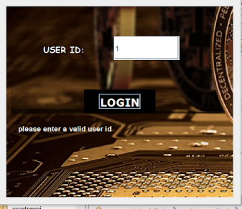
LogIn Page
Enter issued User Id.
Click on the Login Button.
Warning appears if:
User Id is invalid.
User Id is not entered

Slide 9
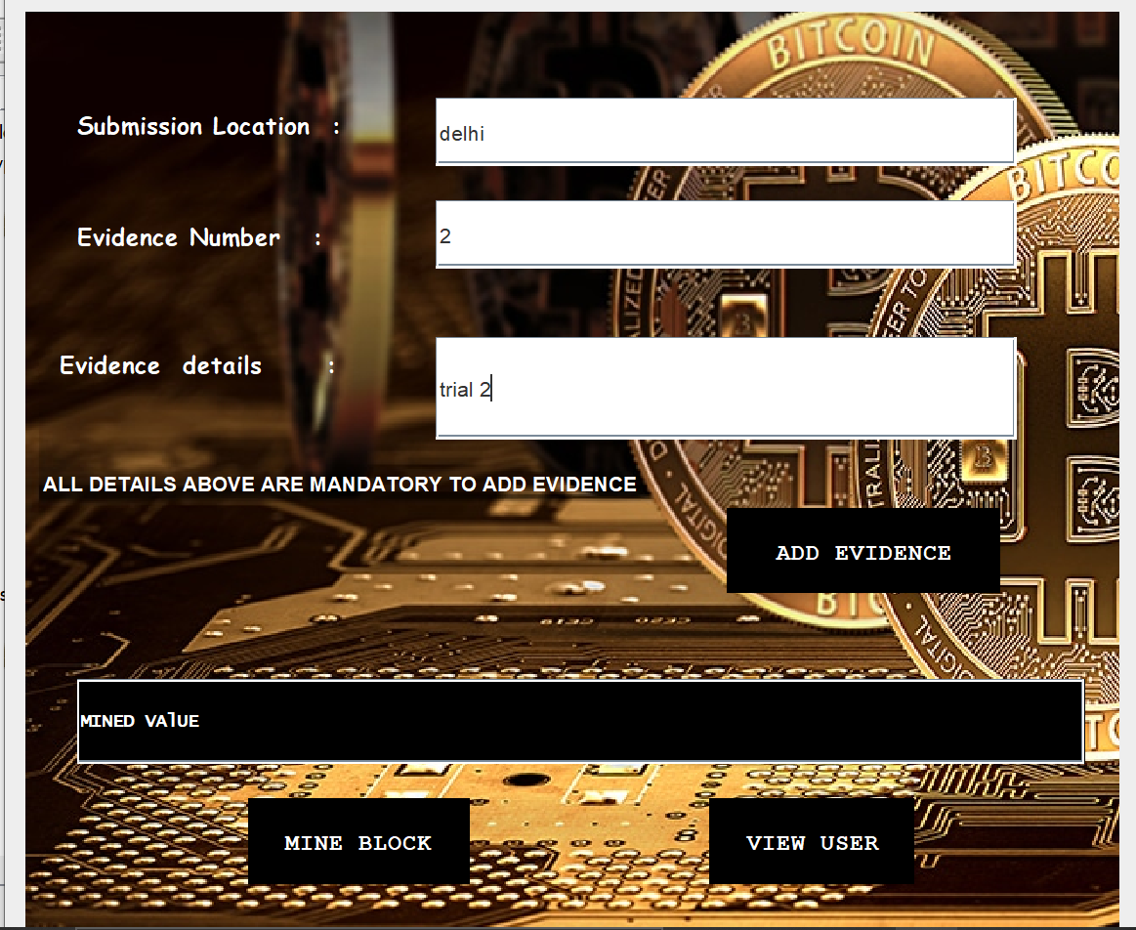
Homepage
Enter the following:
Location where evidence is submitted
Evidence Number
Details include type of evidence found(gun,blood,fingerprints etc.)
Click on ‘Add Evidence’ .
This button will go on to use ZKP to verify the transaction
Only after transaction is verified, it can be added to the blockchain.
Fingerprints

Slide 10
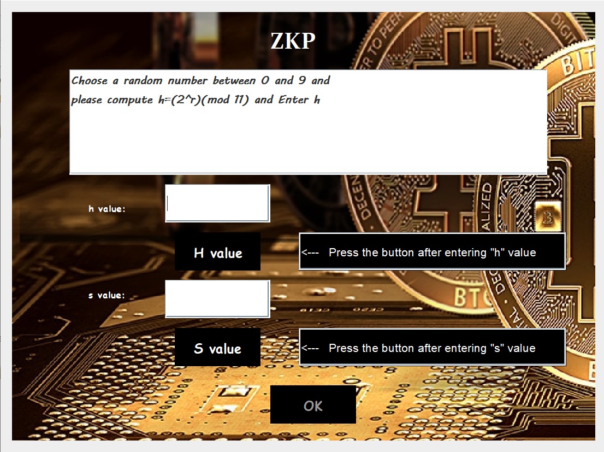
Verify Transaction()
The case has a unique password that will be known only to valid users.
This will be treated as sensitive information (x) that the user has to prove they know.
For simplicity we have chosen case password (x)=2, and g=2 & p=11.
STEP 1: User chooses random number (r) and computes (h) according to the given instructions.
Screenshot showing process of zkp

Slide 11
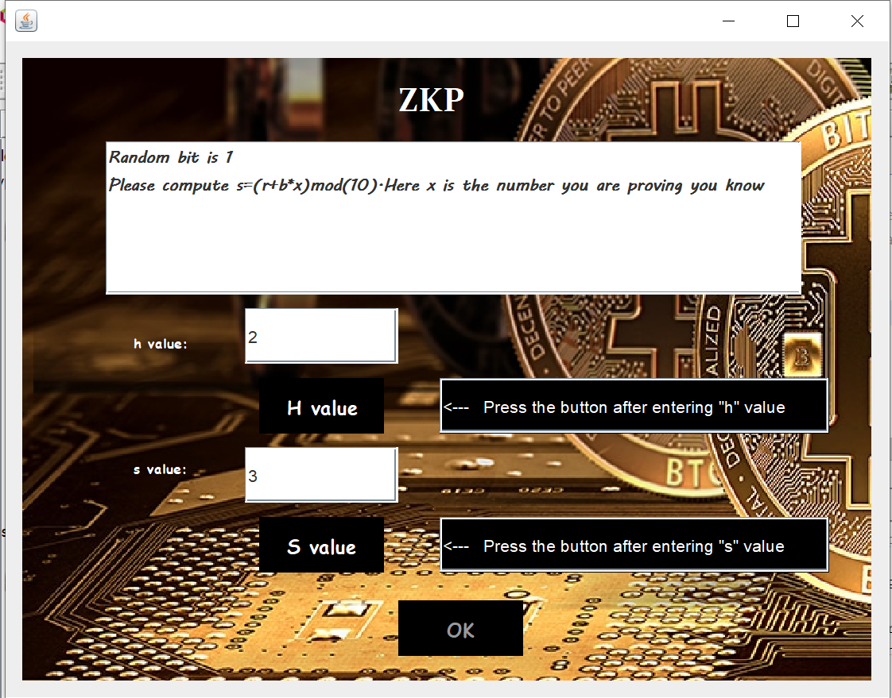
STEP 2: Verifier returns random bit (b) , follow instructions to compute (s).
Click on button S value.

Slide 12
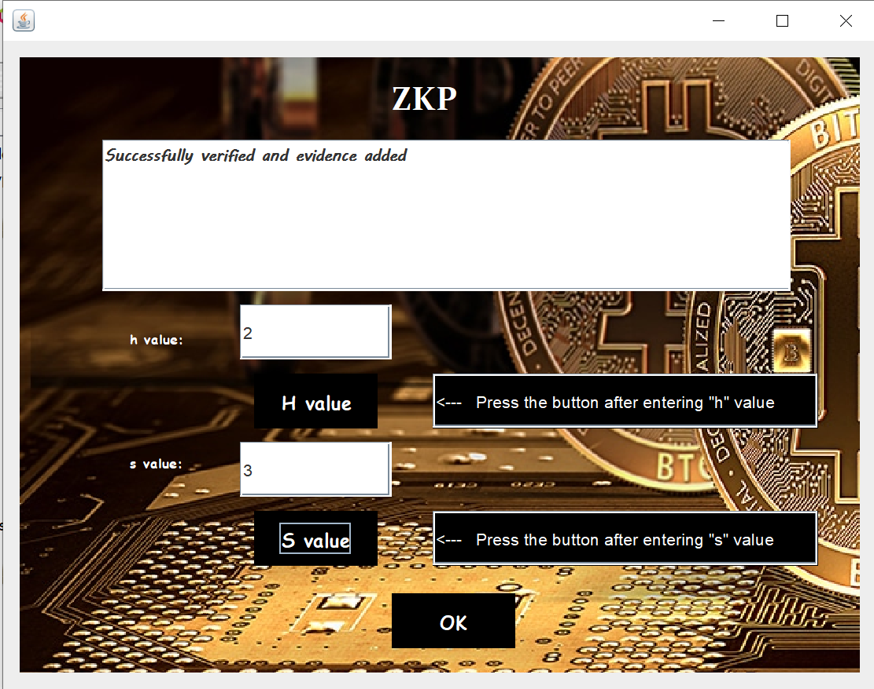
If (g^s)modp = h(y^b)modp then zero knowledge proof is complete and transaction is verified.
OK button is now enabled.
Click to complete transaction.
The block is now added to the blockchain.

Slide 13
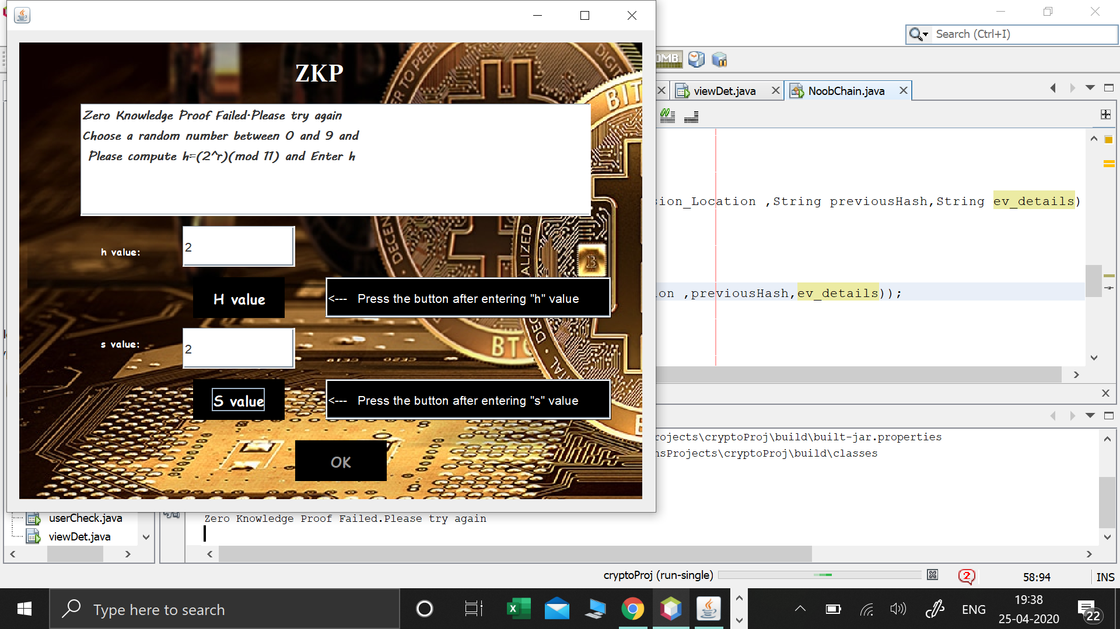
If the values don’t match, messages showing error is displayed.

Slide 14
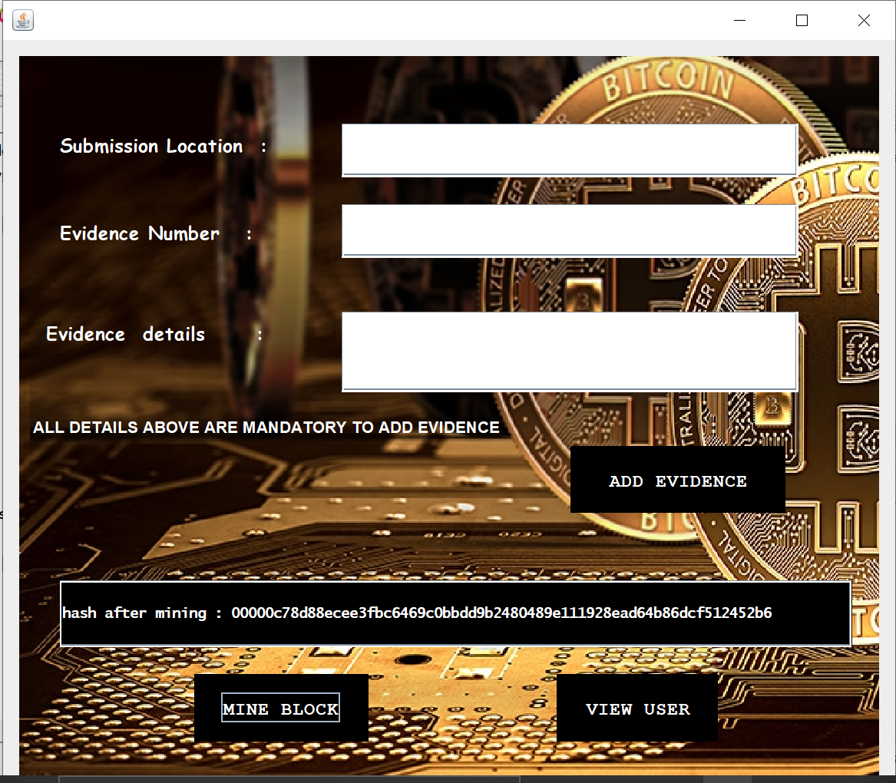
Mine Block
Now, Mine Block button is active and when clicked on, mines the block and displays the hash value in the box.
You can now click on View User to view the current blockchain.

Slide 15
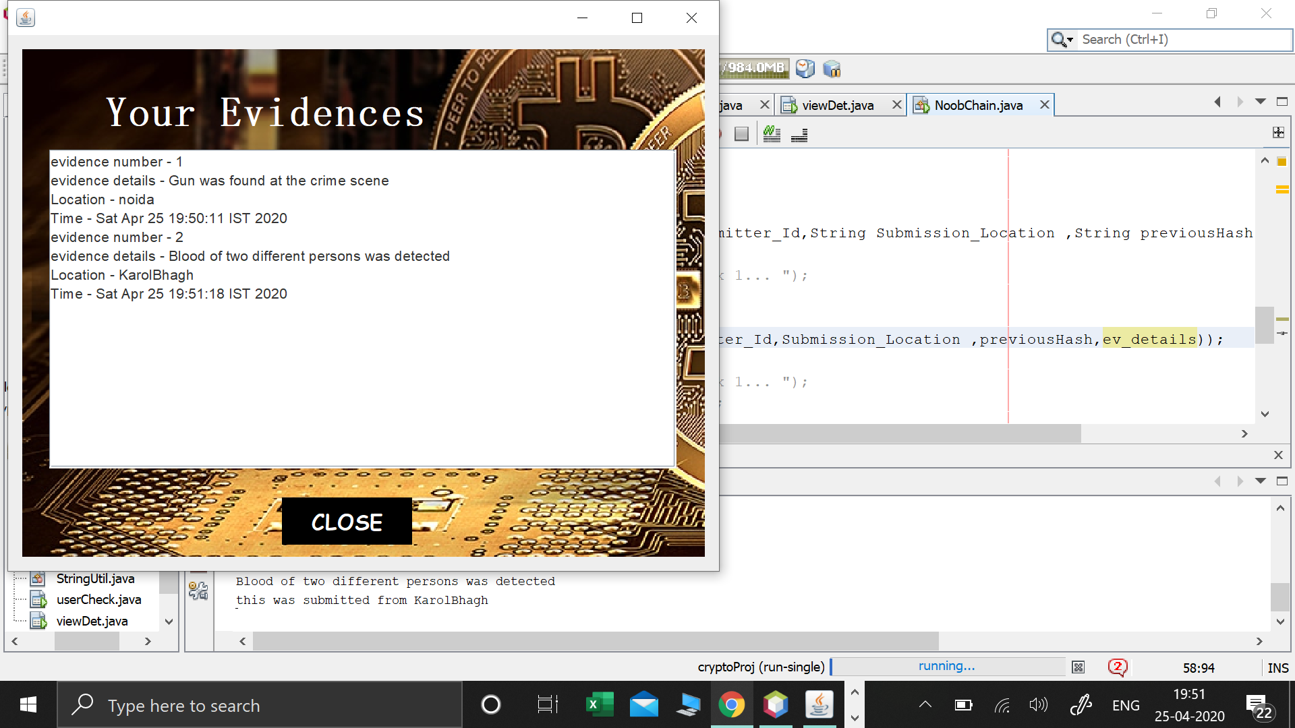
View User
This page displays the data present in the current blockchain.
This includes-
Evidence number
Evidence details
Location where it was submitted
Timestamp.
Click on Close to close the page.

Slide 16
Conclusion
With the help of our blockchain implementation, evidence can be uploaded and accessed securely by authorized personnel only.
This helps curb the tampering and mishandling of evidence that is crucial to the case.
The implementation can be further scaled up to add hundred of users and databases which will potentially allow the Police force to use it in the future.
Specifications:
Hashing Algorithm: SHA-256
Language used: Java

